Slide 1
FINGER IDENTIFIER
AVIRAT GUPTA
JC BOSE UST
4th August ,2020

Slide 2
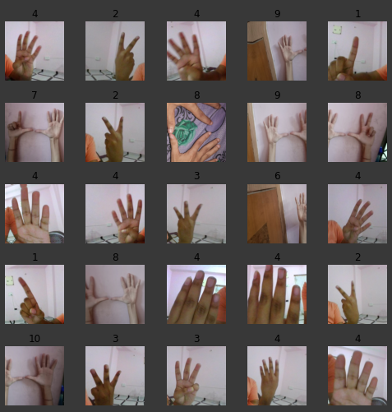
It is a minor project in which we are training our dataset model. The goal of the project is to build a model which is able to count fingers displaying in the image .We present a deep learning model which is used for counting finger and estimate number.

Slide 3
keywords used in project:-
DEEP LEARNING
FINGER RECOGNITION
DATASET
KAGGLE
Fastai
ImageDataBunch
CNN_LEARNER
FIT_ONE_CYCLE
EPOCH

Slide 4
Technical things in the project:-
We are using kaggle to import dataset which we are using in our project.
We are using resnet50.
Various important libraries like fastai , warnings and pandas.
We are using cv2 library for the video.
cnn_learner is used for training of data.
We are making a predictor function to do the prediction of our trained images.

Slide 5
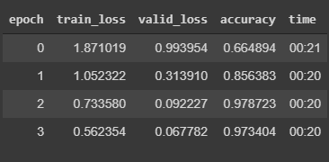
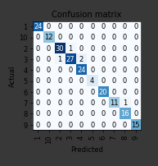
Trained data :-

Slide 6
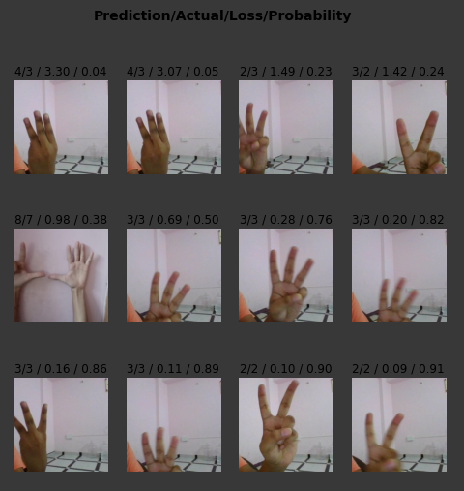
Results:-

Slide 7
Reference:-
Stackoverflow
Github
Kaggle
Google colab
Fast.ai
Various other sites.

Slide 8
Thank you…

